Slide 1
Crumple and Shoot Quiz
Year 7
Solving Problems with Equations

Slide 2
How Crumple and Shoot works
There are 13 questions, with some fun ones included
Each question has a timer. Once the timer is done put your whiteboard marker down and show your answers to the teacher.
If you got the answers correct you get to shoot the ball into the bin. Where you stand depends on the amount of points you get.
Work in pairs, calculator allowed

Slide 3
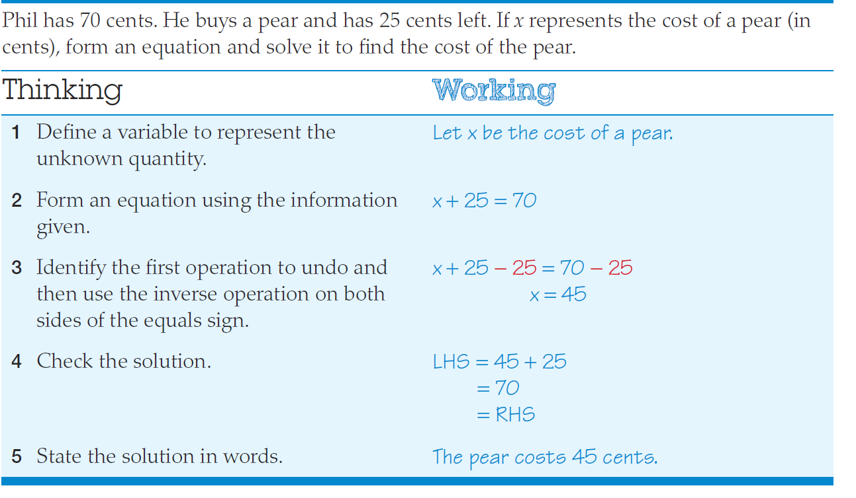
Example

Slide 4
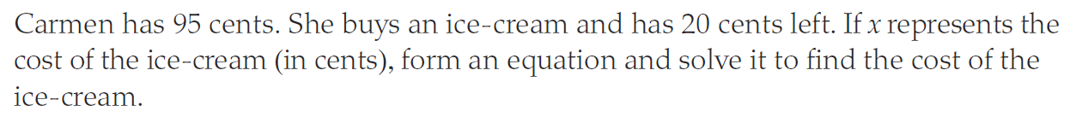

Question 1
2 minutes
$$x+20=95$$
Ice cream cost 75 cents

Slide 5
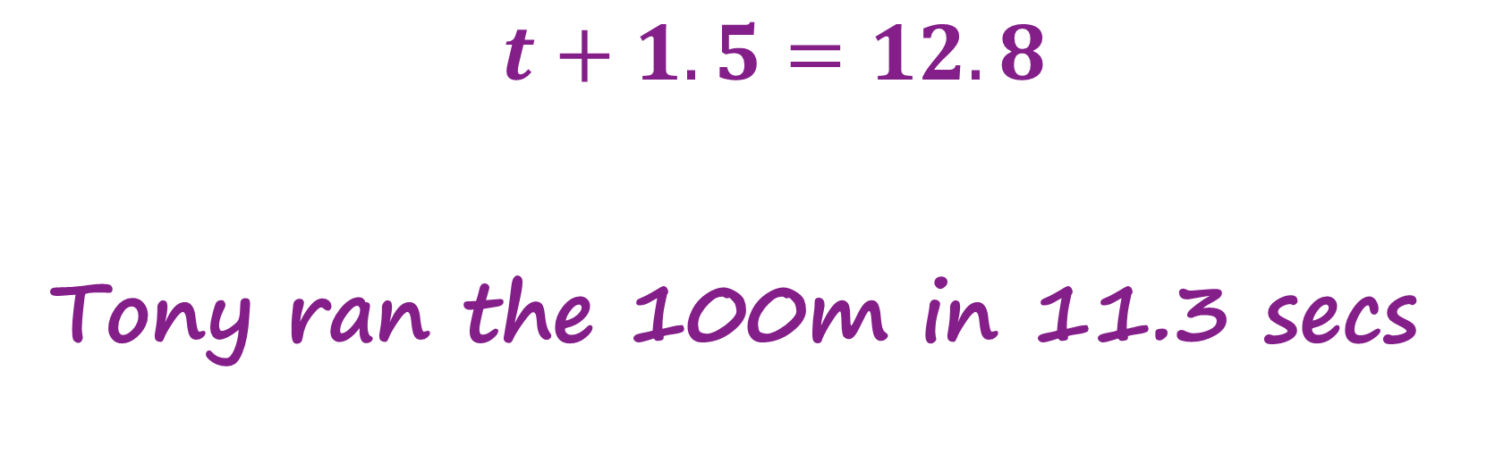
Question 2
2 minutes
$$t+1.5=12.8$$
Tony ran the 100m in 11.3 secs

Slide 6
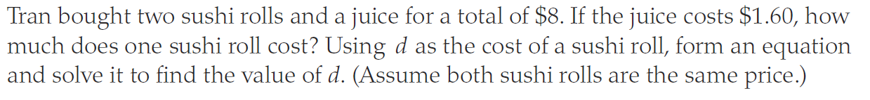

Question 3
$$2d+1.60=8$$
The sushi cost $3.20 each
2 minutes

Slide 7
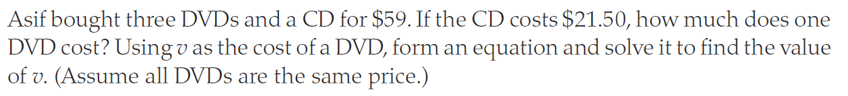

Question 4
$$3v+21.50=59$$
The DVD’s cost $12.50 each
2 minutes

Slide 8

Question 5
Who is this person?
Alice

Slide 9
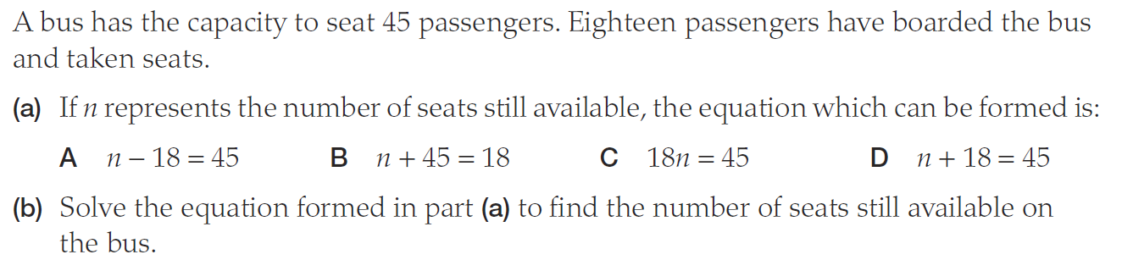
Question 6
2 minutes
D
N = 27 seats still available

Slide 10
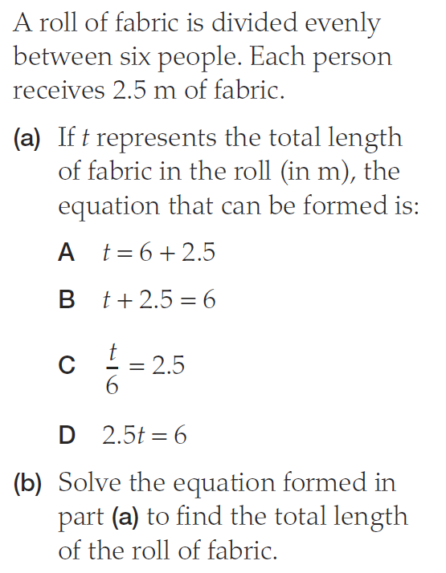
Question 7
C
T = 15m of fabric
2 minutes

Slide 11
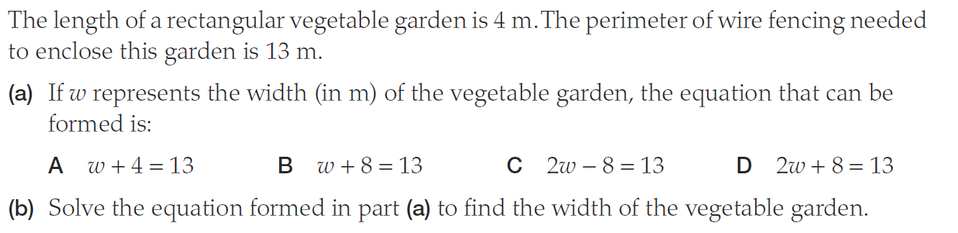
Question 8
D
W = 2.5 meters
2 minutes

Slide 12
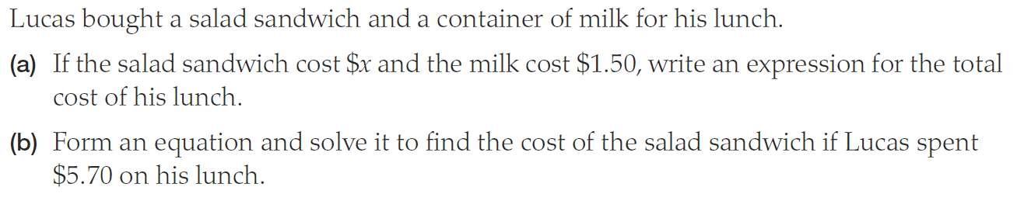
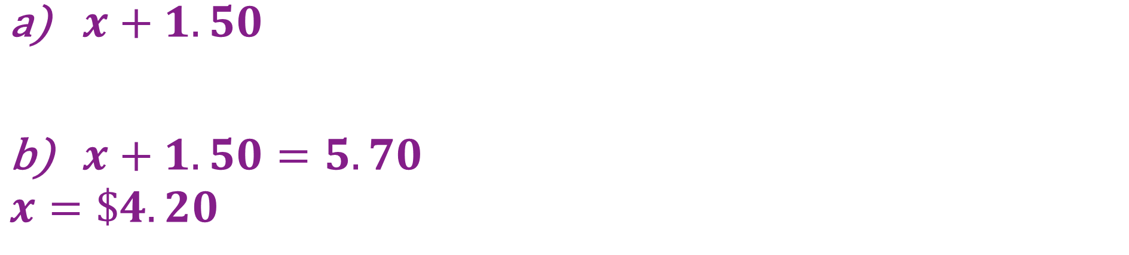
Question 9
$x+1.50$
$x+1.50=5.70$
$$x=\$4.20$$
3 minutes

Slide 13

Question 10
Who is this person?
Merida

Slide 14
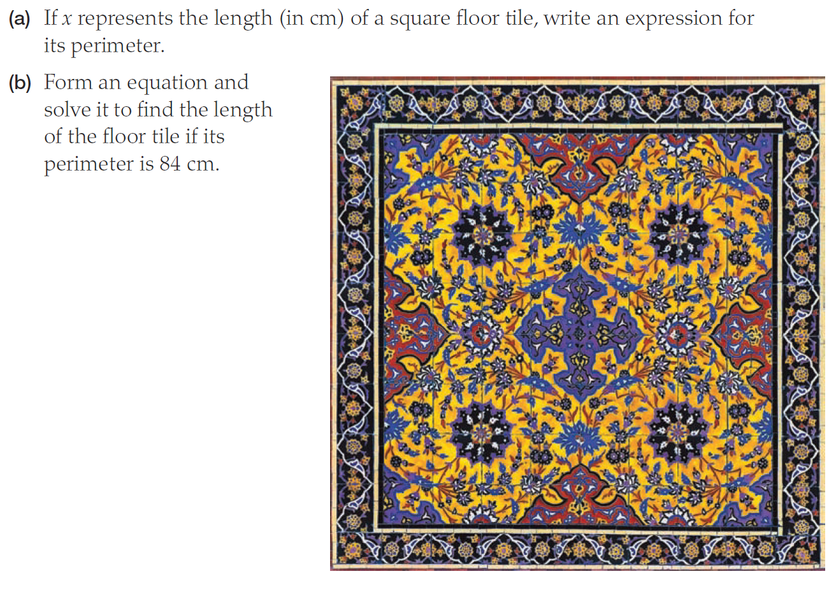
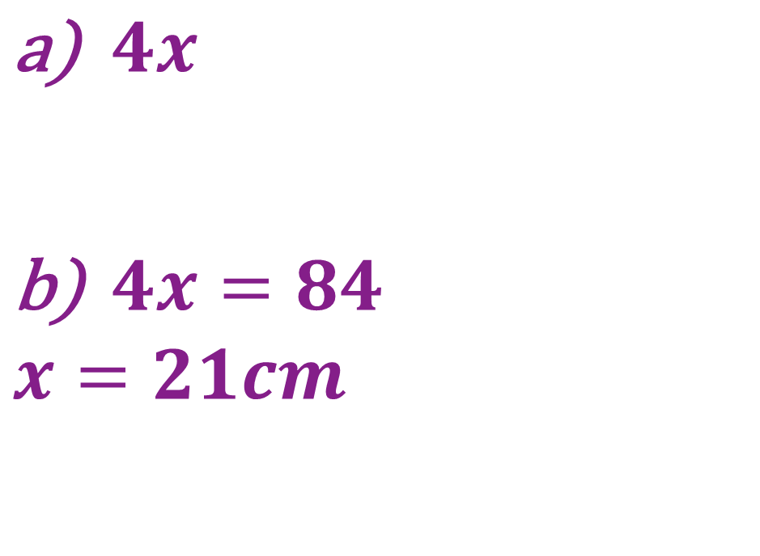
Question 11
$4x$
$4x=84$
$$x=21cm$$
3 minutes

Slide 15
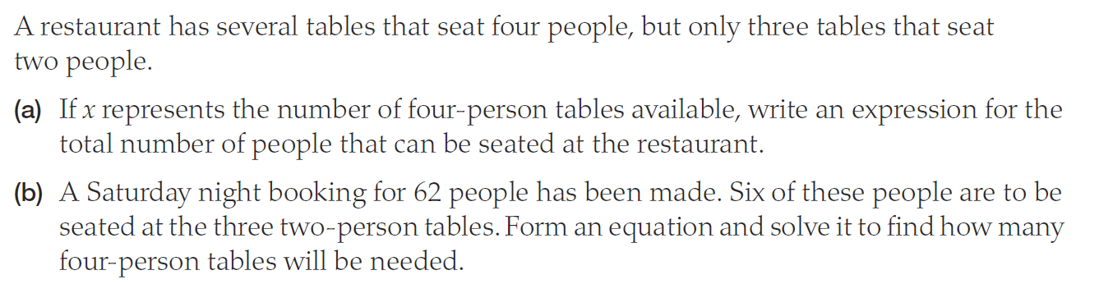
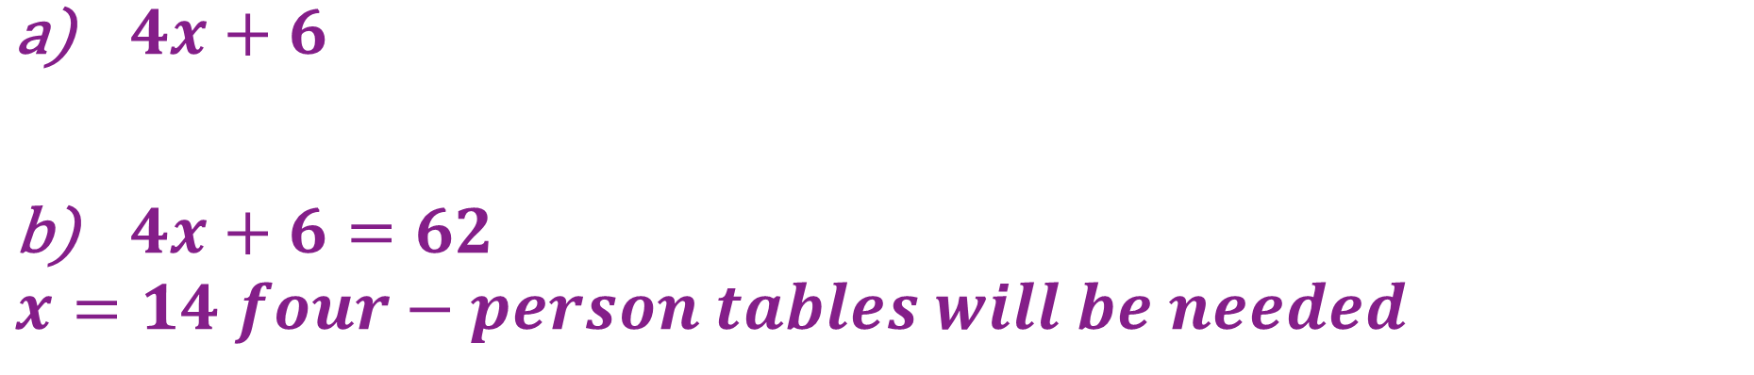
Question 12
3 minutes
$4x+6$
$4x+6=62$
$$x=14 four−person tables will be needed$$

Slide 16

Question 13
Who is this person?
Arial

